Slide 1
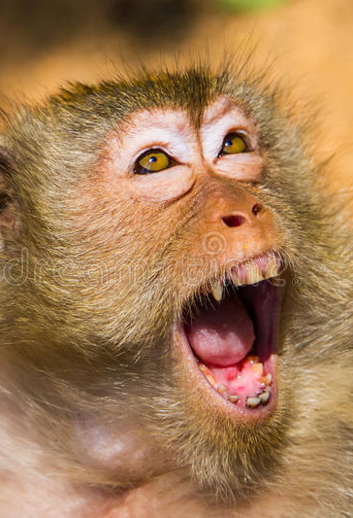
Sustainable Ecology for peaceful coexistence of Humans and Wild animals
Presented By
Debopriyo Mallick (A21010)
Gulivindala Naveen Kumar (A21014)
Pratyush Nayak (A21023)
Shubham Bathwal (A21031)
Gargi Goswami (A21039)

Slide 2
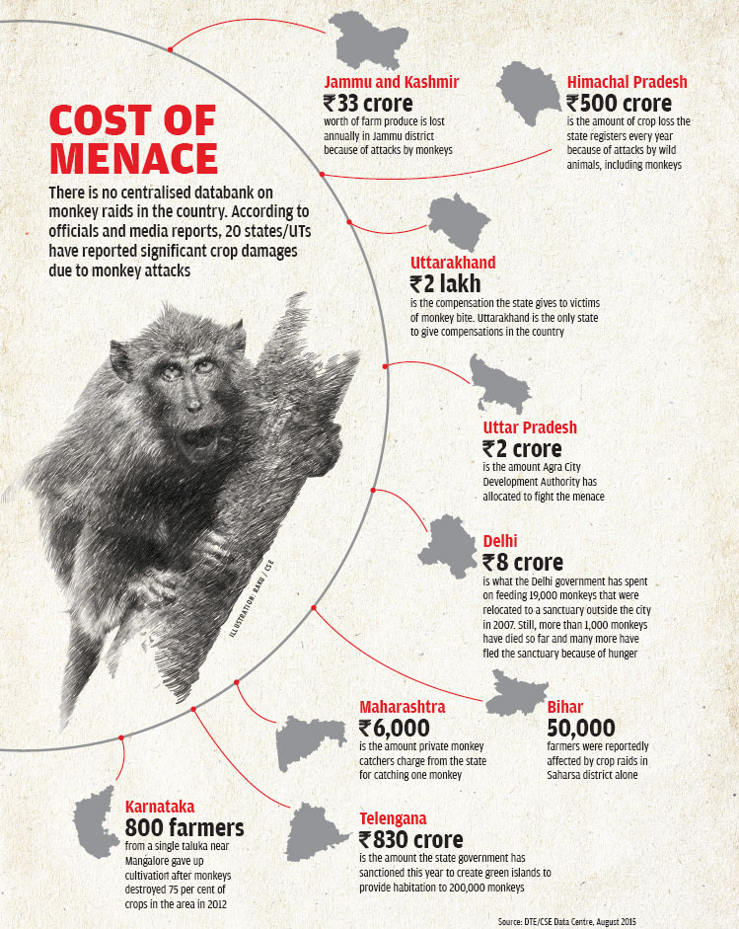
Monkey Menace
38 monkeys found dead near Belur was a result of villagers’ attempt to get rid them from damaging their crops – The Hindu (05 Aug)
The High Court of Karnataka directed the State government, the Forest Department and the Bruhat Bangalore Mahanagara Palike (BBMP) to evolve a scheme to protect residents of Bengaluru from the menace of monkeys and to ensure that they are driven back to their natural habitats in a humane way. – Indian Express (10 July)

Slide 3
Business Problem
Animal trespassing in human territory has become frequent these days. With depleting habitat of these creatures, they are bound to move towards new settlement, a common survival instincts for all of us. The primary reason behind incursion of wildlife into the town is its location. It’s flanked on all sides by multiple critical wildlife habitats. Animals generally walk into the human settlements for food and shelter.
The problem arises when these animals clash with humans. Many such scenario are becoming apparent nowadays, but can we blame them for that ; with expanding cities , continuous deforestation and increasing pollution level we are one of the major cause for their habitat loss. So, what is the most sophisticated way to solve this problem
Afforestation

Slide 4
problem statement
Problem
Cease Monkey infiltration in Human settlement
Proposed solution
Create permanent habitat for Monkeys (basically creating a Sanctuary)
Make it possible by afforestation (plant selection) but in the planned way:
Area specific plantation
Knowledge of Monkey habitation
Climate and surrounding conditions
Plants ecosystem understanding

Slide 5
DATA NEEDED
Geographical Attributes
State
District
Soil Attributes
Nitrogen
Phosphorus
Climatic Attributes
Precipitation
Potassium
pH Value
Average Temperature
Relative Humidity
Sunlight Hours
Target - Plant

Slide 6
DATA NEEDED - Continued
Source
Soil Data - https://www.soilhealth.dac.gov.in
Weather Data - https://en.climate-data.org
Plant Data – https://garden.org

Slide 7
PROPOSED SOLUTION
Unlabeled
Data
Data Preprocessing
Model
Data Transformation
Target
Labelled Data
Data Preprocessing
Cleaning
Imputation
Data Transformation
Feature Scaling - Normalization
Data Encoding
Integrity
Classification Model
K – Nearest Neighbors
Evaluation
Validation
MODEL BUILDING
MODEL EXECUTION

Slide 8
IMPACT ON BUSINESS
Area specific plantation could lead better and stable growth of environment.
Government as well as NGO like Green Army take the benefits of the model.
Help understanding plant growth and suitable environment for them.
Help to deal with alien species of plant.
Can be helpful in reducing soil erosion.

Slide 9
THANK YOU

